Slide 1



Slide 2
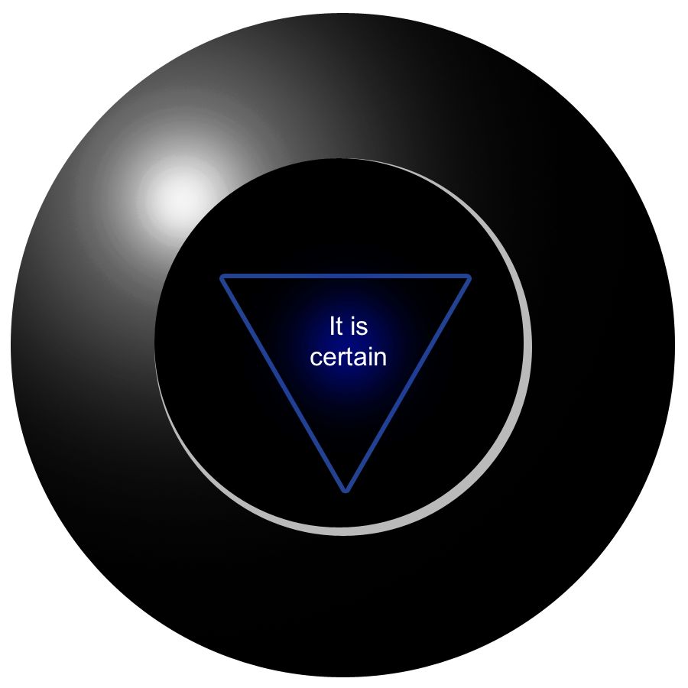

Slide 4

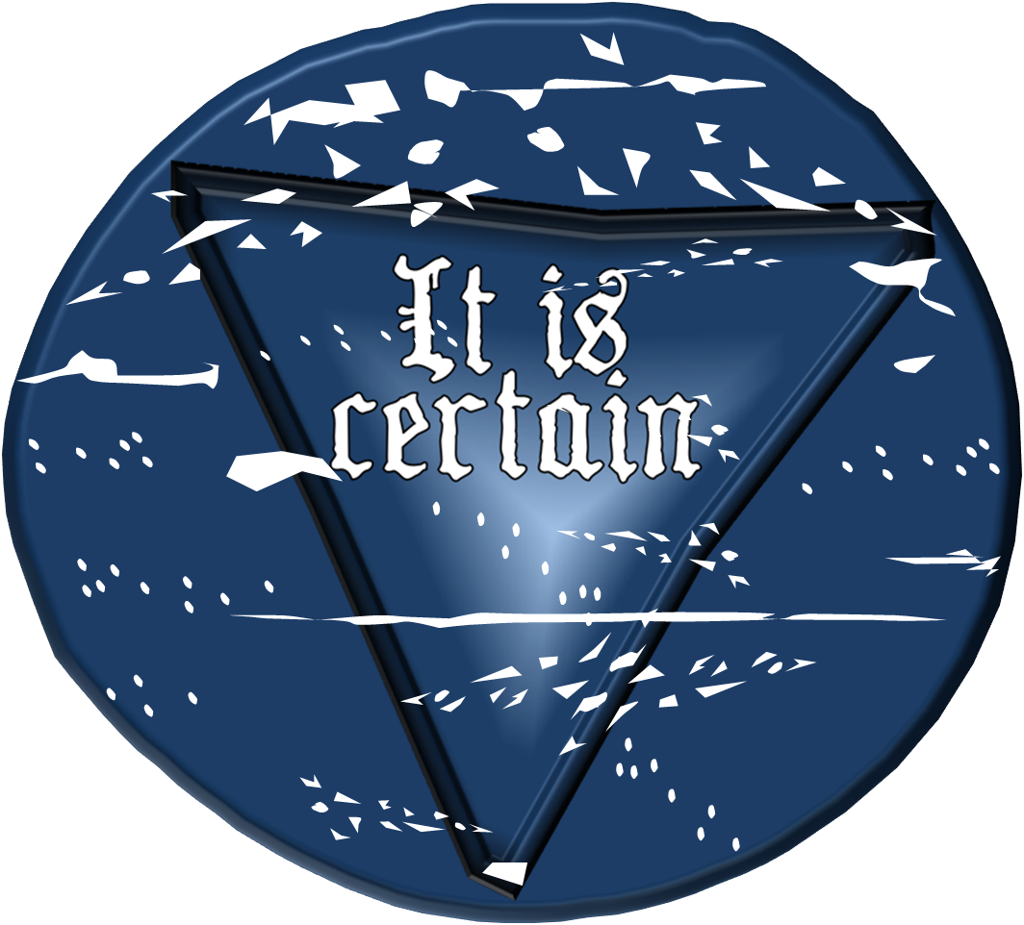

Slide 5




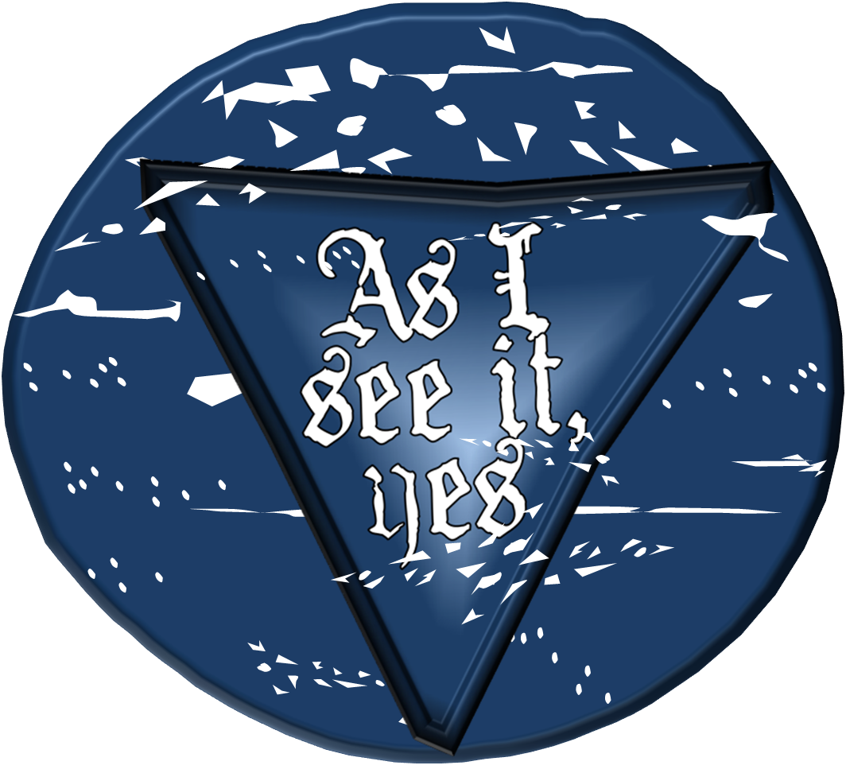
















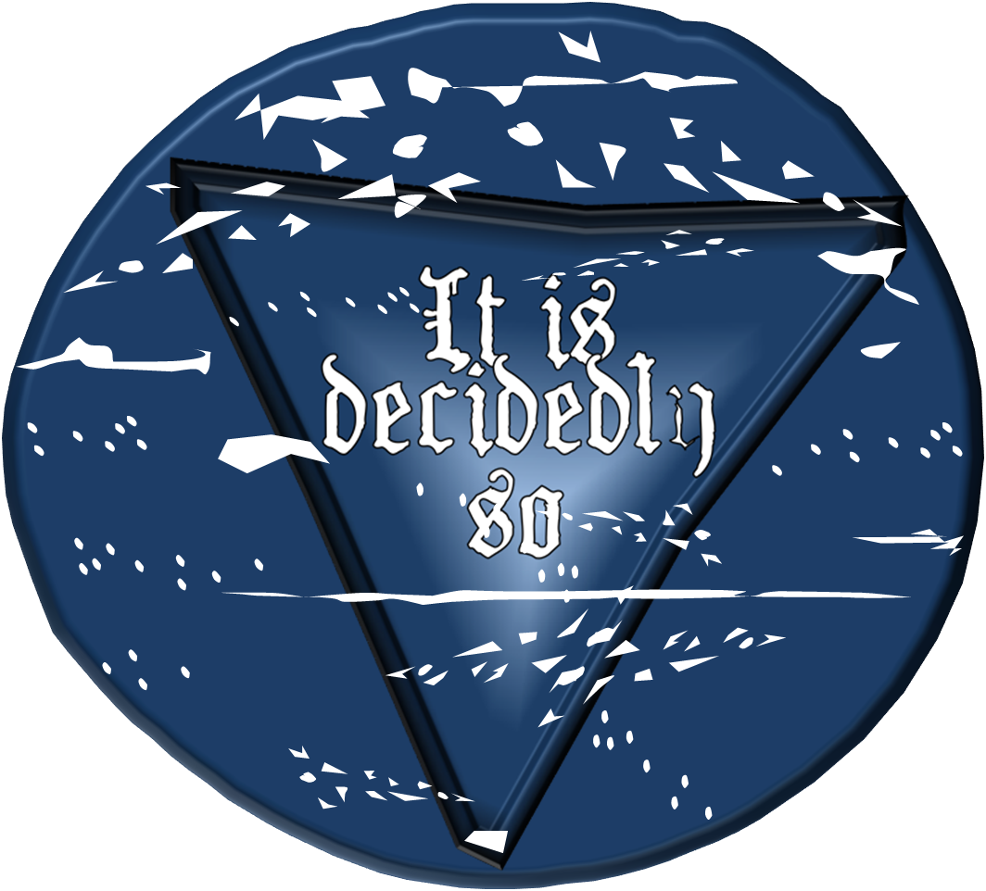

Slide 6


Slide 7


Slide 8












Slide 9









Slide 10

Very
doubtful
good

Slide 11



